Slide 1
TypeScript #1

Slide 2
Objectives
By the end of this session, You will be able to:
Understand why TypeScript exists and how it evolved.
Learn the difference between static vs dynamic typing.
Explore TypeScript’s main features (types, inference, interfaces, generics).
Learn what transpilers do and how TSC works.
Configure TypeScript using tsconfig.json.
See how TypeScript fits into modern build workflows

Slide 3
Don’t forget our Rules
15 mins late is acceptable, after 15 mins every minute is equal to 1 pound. max(20 pounds)
Absence without any excuse -> 2 warnings
Missing Task without any excuse -> 1 warning
Any unacceptable behavior -> warning

Slide 4
Don’t forget our Rules
Any correct answer in the session = Mohsens
Best member of the week will be awarded next session
Best of the month will be awarded 1/12 based on mohsens
Best of the Season will be awarded at the end of the season based on mohsens and overall performance

Slide 5
01
Recap
What happened last Session?
What did we talk about?
What was the benefit you got from last session?

Slide 6
Table of Content
1_ Problem with JS
2_ How the Problem is Solved
3_ What is TypeScript
4_ Basics of TypeScript
Union Types
Intersection Types
Generic Types
classes
Type vs Interface vs Class vs Object
Types
Functions
Arrays
Interfaces

Slide 7
Table of Content
5_ code Structure Different Philosophies
6_ How TS is Transpiled
7_ How to set it up
8_ What Files Matters to us

Slide 8
Who here hates JS?

Slide 9
</ JS development:
JavaScript is awesome for building things, but it can get chaotic.
Suddenly you’re debugging for hours, and the bug?
Something JS didn’t warn you about until it exploded at runtime.

Slide 10
How was this problem fixed?

Slide 11
</ TypeScript was the answer
Microsoft introduced TypeScript as a solution:
Code is safe and type annotated
Bugs appear early in compile time
Maintaining Large projects became easier.

Slide 12
What is TypeScript?

Slide 13
</ TypeScript, JavaScript’s cousin
TypeScript is a superset of JavaScript,
Where it includes static types, and can also be dynamically typed.
TypeScript is also not “Compiled” but rather Transpiled – converted into JavaScript code, but why?

Slide 14
</ Quick fact
When TypeScript was created, no browser or runtime could execute TypeScript directly.
So TypeScript had two choices:
Option A:
Create a new runtime or virtual machine that understands TypeScript → Not practical.
It would break compatibility with the entire JS ecosystem.
Option B:
Compile TypeScript into JavaScript, which browsers already understand.
TypeScript chose 100% compatibility with existing JavaScript engines, so it had to be transpiled.

Slide 15
</ Dynamic vs Static Typing
Dynamic typing means type checking happens at runtime, not during compilation. (e.g. Python, JavaScript)
While Static typing is that the type checking happens during writing code, so errors appear early on. (e.g. C++, Java)

Slide 16
Quick Competition
Why do we say compilation time even tho JS is interpreted and what is a LSP?
First one to answer => 5 mohsens

Slide 17
Table of Content
1_ Problem with Js
2_ How the Problem is Solved
3_ What is TypeScript
4_ Basics of TypeScript
Union Types
Intersection Types
Generic Types
classes
Type vs Interface vs Class vs Object
Types
Functions
Arrays
Interfaces

Slide 18
TypeScript Basics

Slide 19
1- Types:
let Name: string = "Mohsen";
let Age: Number = 28;
let isCool: Boolean = true;
You can also define your own type, for example:
type Committee = "Backend" | "Linux" | "Frontend";

Slide 20
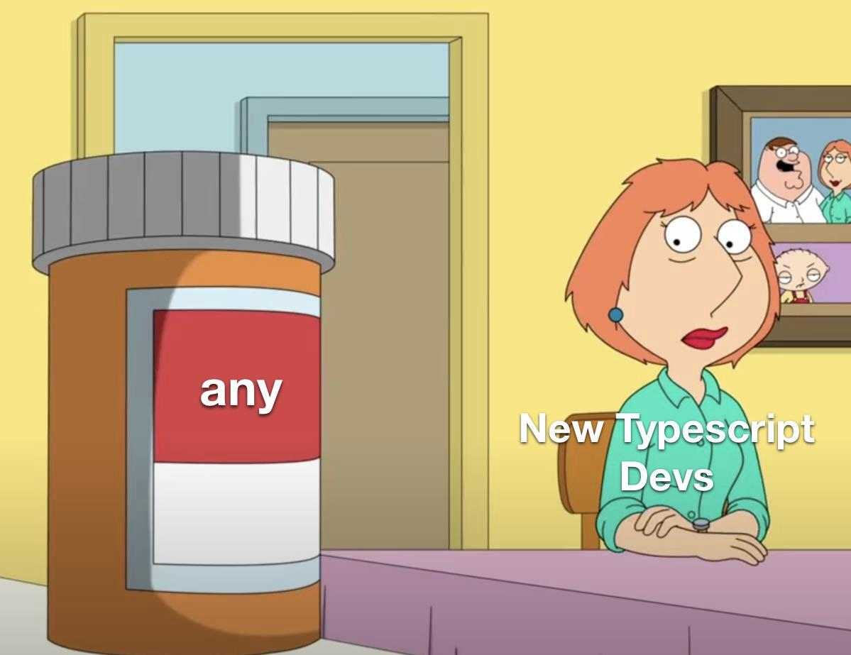
extra- WD-40 of TypeScript:
The Any keyword is used when you don’t expect a certain data type, like what JavaScript does.
Example:
let age: any;
age = "hello world";
age = 32;
Notes:
For a better alternative search about unknown type

Slide 21
Union Types:
let age: Number | String = "8";
As you can see we can here use the pipe operator “ | ” to declare that a variable may have 2 different data types.

Slide 22
2- Functions:
function functionName(Parameters: parameterType): ReturnType {
Function body
}
Example:
function Greet(name: string): void {
console.log(`Hello ${name}`)
}

Slide 23
Arrow function
const fun:()=>string=()=>{
return "hello"
}
const sum:(x:number,y:number)=>number=(x,y)=>{
return x+y
}

Slide 24
function CalculateArea (Length, Width) {
return Length*Width;
}
let area = CalculateArea(2,3); // Works fine
area = CalculateArea(2,"3"); // Works fine (isn’t supposed to)
JavaScript
function CalculateArea (Length: number, Width: number): number {
return Length*Width;
}
let area = CalculateArea(2,3); // Works fine
area = CalculateArea(2,"3"); // Compile Time error
TypeScript

Slide 25
3- Arrays
let arr =[1,2,3,"hi",true]; //same as
let ar:any[] =[1,2,3,"hi",true];
let array:(string | number )[] =[1,2,3,"hi"];
let a:(string )[] =["yomna","hi"];
let nums:(number )[] =[1,2,3];

Slide 26
3- Arrays
let tuple: [string, number, boolean] = ["Yomna", 25, true];
let readonlyArr: readonly number[] = [1, 2, 3];
let nums: Array<number> = [1, 2, 3];
let names: Array<string> = ["Yomna", "Ali"];
let mixed: Array<number|string> = [1, "hi"];

Slide 27
4- Generic Types:
function identity<T>(value: T): T {
return value;
}
let num = identity<number>(42); // T is number
let str = identity<string>("hello"); // T is string
let auto = identity(true); // T inferred as boolean
This is like generalizing what a function can do to multiple data types.

Slide 28
5- Interfaces:
Think of them as Structs in C++
interface member {
name: String;
age: Number;
committee: String;
}

Slide 29
When this code compiled into JS , it will be:
var mem = {
name: "Mohsen",
age: 28,
committee: "BackEnd" };
console.log(mem);
There is no interface in JavaScript, and TypeScript annotations (: Member) are removed after compilation

Slide 30
Table of Content
1_ Problem with Js
2_ How the Problem is Solved
3_ What is TypeScript
4_ Basics of TypeScript
Union Types
Intersection Types
Generic Types
classes
Type vs Interface vs Class vs Object
Types
Functions
Arrays
Interfaces

Slide 31
6- Intersection Types: “Type Aliases”
type Id = { id: number };
type Name = { name: string };
type User = Id & Name;
let person:User={id:10,name:"yomna"}
Here use the ampersand operator “ & ” to declare that a variable will have the attributes of all types declared.

Slide 32
Another Quest
What is the main differences between interface and type alias ?
First one to answer => 5 mohsens

Slide 33
7-classes
Class = a blueprint for creating objects.
Can contain:
Properties (object variables).
Constructor (function executed when an object is created).
Methods (functions inside the object).

Slide 34
TypeScript: Type vs Interface vs Class vs Object
Type | Interface | Class | Object
Compile-Time Only | Compile-Time Only | Run time | Run time
Disappears after compilation as it is unique for TS | Disappears after compilation as it is unique for TS | Exists at runtime, in the JS code | Exists at runtime, in the JS code
A way to define shapes and aliases for type checking | A contract that defines object structure | A blueprint for creating objects with behavior | Actual data stored in memory

Slide 35
What is partial type ?
In TypeScript, Partial<Type> is a utility type that makes all properties of a type optional.
interface User {
id: number;
name: string;
email: string;
}
const user1: User = {
id: 1,
name: "Yomna",
email: "yomna@example.com"
};

Slide 36
const user2: User = {
id: 2,
name: "Ali"
}; // Error: Property 'email' is missing
BUTT!
const partial_User: Partial<User> = {
id: 3
}; // Works, name & email are optional
## We can use ? => it means optional attribute
name?: "Ali"// Works, name is optional

Slide 37
Table of Content
1_ Problem with Js
2_ How the Problem is Solved
3_ What is TypeScript
4_ Basics of TypeScript
Union Types
Intersection Types
Generic Types
classes
Type vs Interface vs Class vs Object
Types
Functions
Arrays
Interfaces

Slide 38
Table of Content
5_ code Structure Different Philosophies
6_ How TS is Transpiled
7_ How to set it up
8_ What Files Matters to us

Slide 39
</ Top-down vs Bottom-up flows
Top-Down
interface User {
id: number;
name: string;
address: Address;
roles: Role[];
}
interface Address {
city: string;
street: string;
}
type Role = "admin" | "member" | "guest";
Bottom-up
interface Id {
id: number;
}
interface Name {
name: string;
}
type Role = "admin" | "member" | "guest";
interface User extends Id, Named {
roles: Role[];
}
Notes:
Top-Down: Start from the full shape and break down.
Bottom-Up: Start from reusable small types and build up.

Slide 40
Bottom up | Top down
Start small then build up | Start big then break down
Build all pieces then assemble | Write what you want first then define how later

Slide 41
</ Shape Compatibility
If we define multiple interfaces that have common attributes we can assign an object of the more general interface to an object of the narrower scope interface.

Slide 42
Shape Compatibility example
interface Person {
name: string;
age: number; }
interface Employee {
name: string;
age: number;
employeeId: number; }
const p: Person = {
name: "Bianka",
age: 5 };
const e: Employee = p; // Error
const emp: Employee = {
name: "Bianka",
age: 5,
employeeId: 101
};
const person: Person = emp; // works
But it can work in 2 cases! +2 mohsens

Slide 43
Table of Content
5_ code Structure Different Philosophies
6_ How TS is Transpiled
7_ How to set it up
8_ What Files Matters to us

Slide 44
Hands On

Slide 45
Break

